Slide 1
I/O Principles of I/O Software I/O Software Layers

Slide 2
Review
Memory-Mapped I/O
Map all the control registers into the memory space
Each control register is assigned a particular and unique memory address
DMA
A memory address register
A byte count register
One or more control registers
3 modes: Word-at-a-time, Block, Fly-by
Precise vs. Imprecise Interrupt
Precise: Leave the machine in a well-defined state
PC is saved in a known place
All instructions before the one pointed to by the PC have fully executed
No instruction beyond the one pointed to by the PC has been executed
Execution state of the instruction pointed to by the PC is known
Imprecise: Does not meet all requirements as precise

Slide 3
Objectives
Principles of I/O Software
Goals of the I/O Software
Programmed I/O
Interrupt-Driven I/O
I/O using DMA
I/O Software Layers
Interrupt Handlers
Device Drivers
Device-Independent I/O Software
User-Space I/O Software

Slide 4
Principles of I/O Software Goals of the I/O Software
Device independence
Write program can access any I/O device without having to specify the device
Uniform naming
The name of file or device should simply be a string or an integer and not depend on the device in any way
A path name is used to address
Error handling
The problems,that are not able to deal with hardware, should be told by software
Synchronous (blocking) vs. Asynchronous (interrupt-driven) transfer
User program writes if I/O operation are blocking – after a read system call the program automatically suspended until the data are available in the buffer
The CPU starts transfer &goes off to do something else until the interrupt arrives
Buffering
The data must be put into an output buffer in advance to decouple the rate at which the buffer is filled from the rate at which it is empties, in order to avoid buffer under run
Sharing vs. dedicated devices: OS handle to avoid problems

Slide 5
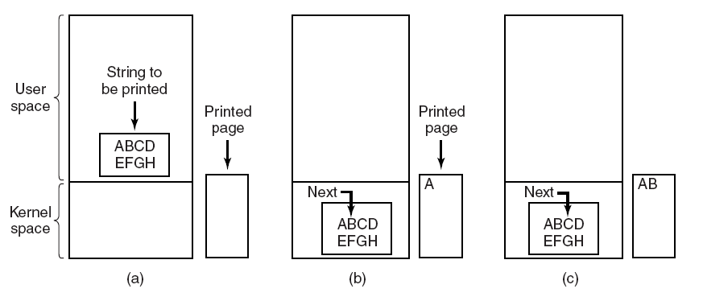
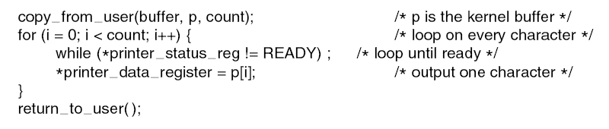
Principles of I/O Software Programmed I/O
The simplest form of I/O is to have the CPU do all the work as
The CPU uses polling to watch the control bit, constantly looping to see whether the device is ready
Making a system call to open the device
If it is available, the data are copied to kernel
Then, CPU polls the device to see if it is ready to accept or not
If it so, the small data is outputted
→tying up the CPU full time until all the I/O is done
Tanenbaum, Fig. 5-7 & 5-8.

Slide 6
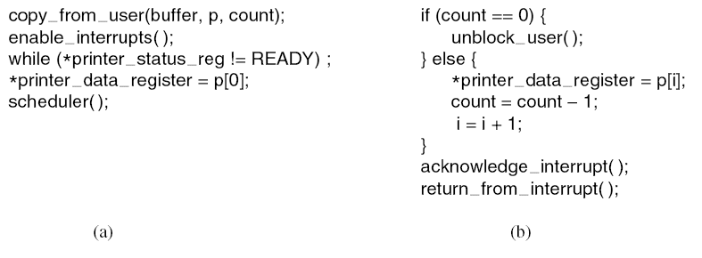
Principles of I/O Software Interrupt-Driven I/O
The way to allow CPU to do something else while waiting for device to become ready is to use interrupts
The CPU does not poll the control bit, it receives an interrupt when the device is ready for next by
Disadvantages: interrupt occurs on every character → wastes a certain amount of CPU time
Tanenbaum, Fig. 5-9.

Slide 7
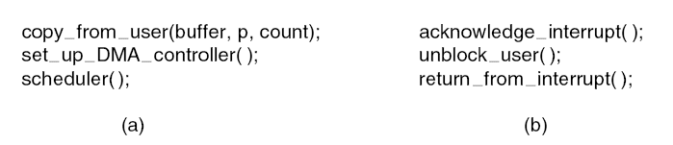
Principles of I/O Software I/O using DMA
Let the DMA controller fetch the characters to device one at time without the CPU being bothered
DMA is programmed I/O
Free ups the CPU during the I/O to do other work
Reducing the number of interrupts and most of the time DMA is worth
→requires special hardware
Tanenbaum, Fig. 5-10.

Slide 8
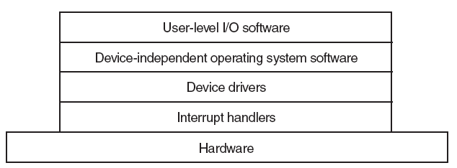
I/O Software Layers Overview
There are 4 layers
Each layer has a well-defined function to perform and a well-defined interface to the adjacent layers
Tanenbaum, Fig. 5-11.

Slide 9
I/O Software Layers Interrupt Handlers
Is a procedure or routine located at fixed address memory
Does whatever it has to in order to handle interrupt
Determines the cause of interrupt
Performs the necessary processing
Executes a return from interrupt instruction to return the CPU to the execution state prior to the interrupt

Slide 10
I/O Software Layers Interrupt Handlers – Example
An outline of a series if steps that must be performed in software after the hardware interrupt has complete
Save registers not already been saved by interrupt hardware.
Set up a context for the interrupt service procedure. (setting up TLB, MMU and page table)
Set up a stack for the interrupt service procedure.
Acknowledge the interrupt controller. If there is no centralized interrupt controller, reenable interrupts.
Copy the registers from where they were saved to the process table
Run the interrupt service procedure. It will extracts information from the interrupting device controller’s register
Choose which process to run next. If the interrupt has caused some high priority process that was blocked to become ready, it may be chosen to run now
Set up the MMU context for the process to run next. Some TLB setup may also be needed
Load the new process’ registers, including its PSW.
Start running the new process

Slide 11
I/O Software Layers Device Drivers
Device driver
Is a device-specific code is used to control and attach the I/O device to a computer
This code is written by the device’s manufacturer and delivered along with the device
Normally handles one device type, or at most, one class of closely related devices
There is no technical restriction on having one device driver control multiple unrelated devices
Is written by outsiders, then will be installed in OS
Are normally positioned below the rest of OS
OS classify drivers into 2 common categories: block devices and character devices
OS define a standard interface supporting all block drivers and a second standard interface supporting all character drivers.
Drivers are not allowed to make system calls, but they often need to interact with the rest of the kernel (calls to certain kernel procedures are permit)

Slide 12
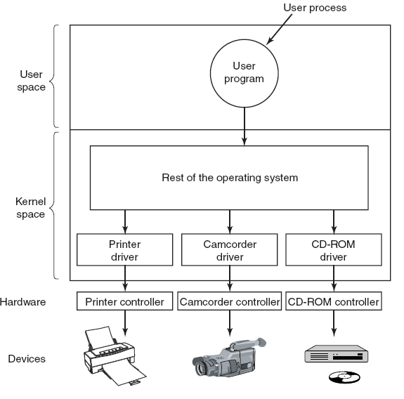
I/O Software Layers Device Drivers
Tanenbaum, Fig. 5-12.

Slide 13
I/O Software Layers Device-Independent I/O Software
The basic function of device-independent software is to perform the I/O functions that are common to all devices and to provide a uniform interface to the user-level software
Some functions as
Uniform interfacing for device drivers
Buffering
Error reporting
Allocating and releasing dedicated devices
Providing a device-independent block size

Slide 14
I/O Software Layers Uniform Interfacing for Device Drivers
Each device driver has different interface to the OS
Driver functions available for system to call differ from driver to driver → differ kernel functions
Taken together, interfacing each new driver requires a lot of new programming effort
All drivers have the same interfaces
It is much easier to plugin a new drivers, providing it conforms to the driver interface
The driver writers know what is expected of them
In practice, not all devices are absolutely identical, but usually there are only a small device types and even these are generally almost the same

Slide 15
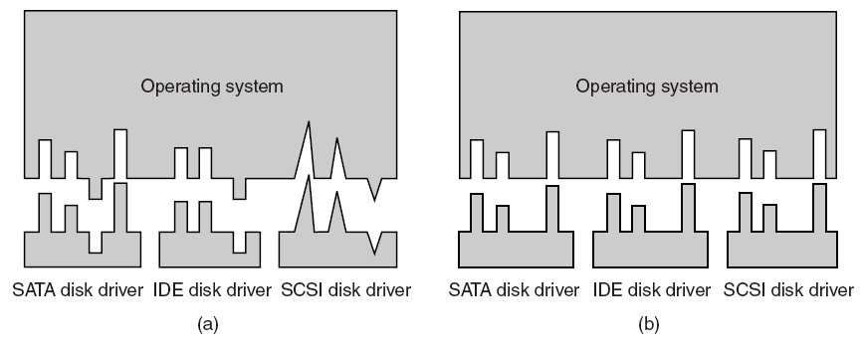
I/O Software Layers Uniform Interfacing for Device Drivers
Tanenbaum, Fig. 5-14.

Slide 16
I/O Software Layers Uniform Interfacing for Device Drivers
A uniform interface is how I/O devices are named
The device-independent software takes care of mapping symbolic device names onto the proper driver

Slide 17
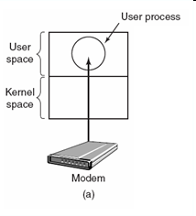
I/O Software Layers Buffering
Is an issue both for block and character devices
Problem
Consider a process that wants to read data from a modem
User process do a read system call and block waiting for 1 character and each arriving character causes an interrupt
The interrupt service hands the character to the user process and blocks it
After putting the character somewhere, the process reads another character and blocks again
→a process must run many times for short runs
Tanenbaum, Fig. 5-15.

Slide 18
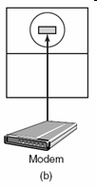

I/O Software Layers Buffering
Buffering in user space
User process provides an n-character buffer in user space
The interrupt service puts the incoming characters in the buffer until it fills up, then wakes up the user processes
Problem
If the buffer is paged out when a character arrives, the buffer could be locked in memory, but if many processes start locking pages in memory, the pool of available pages will shrink and performance will degrade
Buffering inside the kernel
Create a buffer inside the kernel and have the interrupt handler put the characters here.
When the buffer full, the page with the user buffer is brought in, if needed, and the buffer copied there in one operation
Problem
If the kernel buffer is paged out and the user buffer is brought in when a character arrives, there is no place to put them
Tanenbaum, Fig. 5-15.

Slide 19

I/O Software Layers Buffering
Double buffering (inside the kernel)
Two kernel buffers is used, while one is being copied to user space, the other is accumulating new input
Circular buffer
Consists of region of memory and two pointers: one points to the next free work (add new data), other points to the first word of data in the buffer that has not been removed yet (remove and process)
Both pointers wrap around, going back to the bottom when they hit the top
(same as the LSF concept)
Tanenbaum, Fig. 5-15.

Slide 20
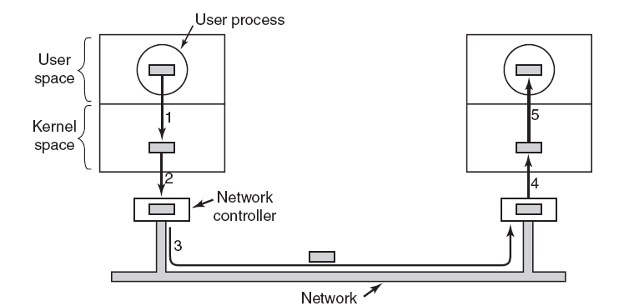
I/O Software Layers Buffering
Buffering is also important on output
The user is free to reuse the buffer the instant it is unblocked
Do not block user in long time (enhance performance) to do something
A downside of buffering
If data get buffered too many times, performance suffers
Slowdown the transmission rate considerably on copying because all the steps process must happen sequentially
Tanenbaum, Fig. 5-16.

Slide 21
I/O Software Layers Error Reporting
Many errors are device-specific and must be handled by the appropriate driver, but the framework for error handling is device independent
I/O Errors
Programming errors
Occurs when a process asks for something impossible
Providing invalid buffer address or other parameter, and specifying an invalid device
→just report back an error code to the caller
Actual I/O Errors
The driver to determine what to do. If it does not know what to do, it may pass the problem back up to device-independent software
When errors occur, the dialog box with message and selected option is showed; or the system display error and terminated

Slide 22
I/O Software Layers Allocating and Releasing Dedicated Devices
Dedicated devices
Are assigned to only one work at a time
To handle the accept or reject requested devices
Process to perform open request on the special files for device directly. If the device is unavailable, the open fails. Closing such a dedicated device then released it
An attempt to acquire a device that is not available blocks the caller instead of failing. Blocked process are put on a queue. Sooner or later, the request device become available and the first process on the queue is allowed to acquire it and continue execution.

Slide 23
I/O Software Layers Device-Independent Block Size
Different disks may have different sector sizes
It is up to the device-independent software to hide this fact and provide a uniform block size to higher layers by treating several sectors as a single logical block
The higher layers only deal with abstract devices that all use the same logical block size, independent of the physical sector size
Similarly, some character devices deliver their data one byte at the time, while others deliver theirs in larger unit

Slide 24
I/O Software Layers User-Space I/O Software
Spooling
Is a way of dealing with dedicated I/O devices in a multiprogramming system
Example for printing task, suppose a process opened it and then did nothing for hours, no other process could print anything
→ the spooling directory (special directory) and daemon (special process)
To print the file, a process first generates the entire file to be printed and puts it in the spooling directory
It is up to the daemon, which is the only process having permission to use the printer’s special file, to print the files in the directory

Slide 25
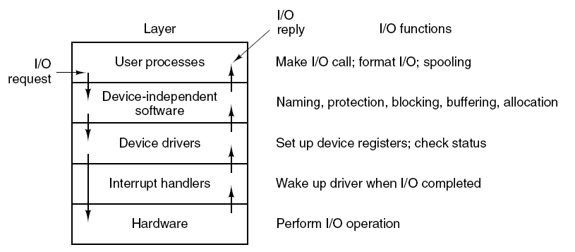
I/O Software Layers Summarize
Tanenbaum, Fig. 5-17.

Slide 26
Summary
Principles of I/O Software
I/O Software Layers
Q&A

Slide 27
Next Lecture
Disks

